Slide 1
Module 3
Development of quality plans and objectives, Total Quality Management (TQM) concepts, Evaluation of quality models and standards (ISO, CMM, Six Sigma), Addressing quality challenges, Significance of national quality awards.

Slide 2
Quality Plan
A Quality Plan is a document that describes how quality requirements will be achieved for a product, project, or process.
It acts as a roadmap showing what quality standards are to be followed, who is responsible, and how quality will be monitored and improved.
Components of a Quality Plan
Quality policy
Quality objectives
Roles and responsibilities
Standards and procedures to be followed
Quality control & quality assurance methods
Documentation and records
Review and corrective actions

Slide 3
1. Quality Policy
The quality policy is a formal statement by top management that expresses the organization’s commitment to quality.
Purpose:
Defines overall quality intentions and direction
Acts as a guideline for setting quality objectives
2. Quality Objectives
Quality objectives are specific, measurable goals that the organization aims to achieve regarding quality.
Characteristics:
Based on the quality policy
Measurable and time-bound
Aligned with customer expectations
3. Roles and Responsibilities
This component defines who is responsible for quality-related activities at each level.
Purpose:
Avoids confusion and overlap
Ensures accountability

Slide 4
4. Standards and Procedures to be Followed
This section specifies the quality standards, guidelines, and procedures that must be adhered to.
Includes:
ISO 9001 standards
Company-specific procedures
Industry regulations
5. Quality Control (QC) & Quality Assurance (QA) Methods
Quality Control (QC)
Focuses on detecting defects
Product-oriented
Quality Assurance (QA)
Focuses on preventing defects
Process-oriented
6. Documentation and Records
This component specifies what documents and records must be maintained.

Slide 5
7. Review and Corrective Actions
This component ensures continuous monitoring and improvement of quality.
Review Activities:
Management reviews
Internal audits
Performance evaluations

Slide 6
Steps to Develop a Quality Plan
Identify customer requirements:
The first step is to clearly understand what the customer expects from the product or service.
Includes:
Functional requirements
Performance expectations
Safety, reliability, and compliance needs
Define quality standards:
Quality standards specify benchmarks and guidelines that must be followed to meet customer requirements.
Includes:
International standards (ISO 9001)
Industry standards
Organizational quality guidelines

Slide 7
3. Set Measurable Quality Objectives
Quality objectives translate standards into specific and measurable goals.
Characteristics:
Quantifiable
Time-bound
Aligned with quality policy
4. Allocate Responsibilities
This step involves assigning roles and responsibilities related to quality activities.
Includes:
Who performs inspections
Who approves quality documents
Who handles corrective actions

Slide 8
5. Select Quality Tools and Techniques
Appropriate quality tools and techniques are chosen to control and improve quality.
Examples:
Checklists
Control charts
Fishbone (cause-and-effect) diagrams
Audits and testing
6. Monitor, Review, and Improve
This step ensures continuous improvement of quality.
Activities:
Monitor performance using metrics
Conduct quality audits
Review results in management meetings
Implement corrective and preventive actions

Slide 9
Quality Objectives
Quality objectives are specific and measurable goals set by an organization to improve and maintain the quality of its products, services, or processes. They are derived from the quality policy and guide employees toward achieving consistent quality and customer satisfaction.
Purpose of Quality Objectives
Improve product and service quality
Increase customer satisfaction
Reduce defects and rework
Support continuous improvement

Slide 10
Examples of Quality Objectives
1. Reduce defects by 20% within 6 months
This objective focuses on process improvement.
What: Defect reduction
How much: 20%
By when: 6 months It helps lower costs, reduce rework, and improve customer confidence.
2. Achieve 95% customer satisfaction
This objective emphasizes customer focus, which is central to quality management. Customer satisfaction can be measured using:
Surveys
Feedback forms
Complaint analysis
High satisfaction indicates that customer expectations are being met.
3. Deliver projects with zero critical defects
This objective aims to ensure high reliability and safety.
Critical defects are errors that can cause system failure or serious customer impact.
Zero critical defects improve trust and reduce post-delivery issues.

Slide 11
SMART - Quality Objectives
To be effective, quality objectives should follow the SMART criteria:
1. Specific
The objective should be clear and precise, not vague.
❌ “Improve quality” ✅ “Reduce software defects in testing phase”
2. Measurable
The objective should be quantifiable, so progress can be tracked.
Examples:
Percentage reduction
Number of defects
Customer satisfaction score

Slide 12
3. Achievable
The objective should be realistic and attainable based on available resources and skills.
❌ Reduce defects by 90% in one month ✅ Reduce defects by 20% in six months
4. Relevant
The objective should support organizational goals and customer needs.
Example: Reducing defects is relevant because it improves product reliability and customer satisfaction.
5. Time-bound
The objective must have a defined time frame.
Example:
Within 3 months By the end of the financial year

Slide 13
Development of Quality Plans and Objectives:
Quality Planning: Quality plans outline the approach to achieving quality in a project or process. It includes defining the quality requirements, setting quality objectives, and establishing the necessary procedures to meet these standards.
Objectives: Quality objectives are specific goals that guide the team toward quality improvement. These objectives are usually measurable, achievable, relevant, and time-bound (SMART).
Process Definition: A critical part of the plan is the identification of key processes that influence quality. This includes defining roles, responsibilities, and methods of measurement and analysis.

Slide 14
To discuss how important is the Quality management in the organization.
The quality is something that evaluates how good is the organization and can satisfy customer by providing best quality in their product and the processes.
It is not about building a project but it is also to build through a process of continuous quality management which embraces terms like ISO 9000, Six Sigma and capability maturity model integration.
ISO 9000 provides a standard which is simply to provide guidelines that defines how a product or a process should be.
The organization follows these standards to define software, hardware, products and support their products delivered to the customers.

Slide 15
Quality is a key factor and it has two different views which is customer and producer view.
Customer view is more subjective and it can be a look, feel and function of the product.
Producer view is objective which is conformance requirements and costs.
Quality of a product can also be evaluated with certain factors like performance which states that whether product is capable of doing its intended job or not, reliability that is how often product will fail, durability which is how long product will last, serviceability which define as how easy it is to repair, aesthetics related with product looks and appearances and conformance to standards. These all are in fact are maintained by ISO 9000, six sigma and CMMI.

Slide 16
Total Quality Management (TQM) Concepts:
Total Quality Management (TQM) is a management approach focused on continuous improvement, customer satisfaction, and employee involvement.
Total quality management is an approach to maintain quality and focus on the cost in order to maintain it. “A process for managing quality”.
The basic aim is to satisfy customers by improving the processes involved to develop a product, and this is done by comprising experiences of the workers.
TQM states that customer decides quality, workers produce it and top management leads it and provides necessary support.

Slide 17
Core Concepts / Principles of TQM
1. Customer Focus
Customer satisfaction is the primary goal of TQM.
Quality is defined by customer needs and expectations
Both external customers (buyers) and internal customers (employees) are important
2. Total Employee Involvement
All employees participate in improving quality.
Employees are encouraged to suggest improvements
Teamwork and empowerment are promoted
3. Leadership Commitment
Top management plays a key role in implementing TQM.
Provides vision and direction
Supports quality initiatives with resources

Slide 18
4. Process-Centered Approach
TQM focuses on improving processes, not just inspecting final products.
Every activity is viewed as a process
Improving processes reduces defects
5. Continuous Improvement (Kaizen)
Quality improvement is an ongoing process.
Small, continuous improvements are encouraged
Uses PDCA (Plan–Do–Check–Act) cycle
6. Data-Driven Decision Making
Decisions are based on facts and data, not assumptions.
Use of quality metrics and statistical tools
Performance is measured and analyzed

Slide 19
7. Integrated System
All departments work together toward common quality goals.
Aligns policies, objectives, and processes
Ensures consistency across the organization
8. Mutually Beneficial Supplier Relationships
Strong relationships with suppliers help improve quality.
Focus on long-term partnerships
Suppliers are treated as partners, not just vendors

Slide 20
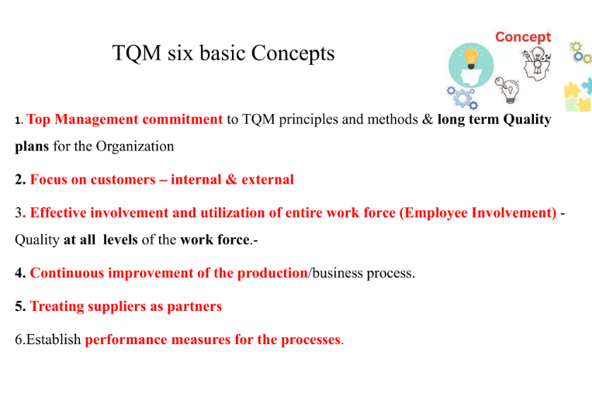

Slide 21
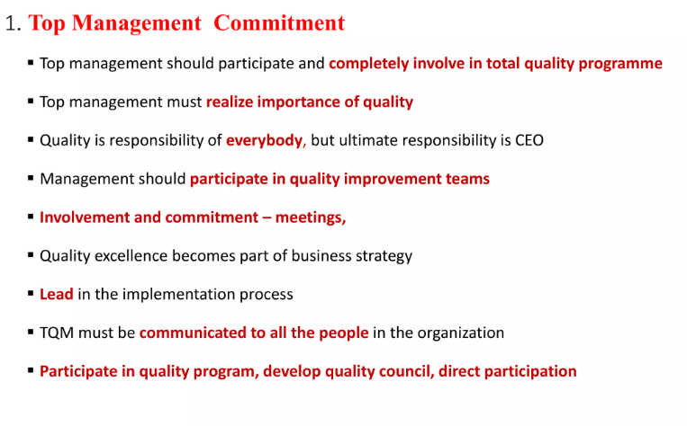

Slide 22
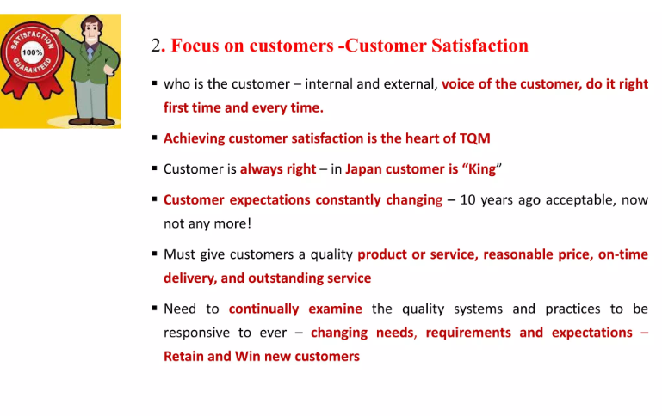

Slide 23
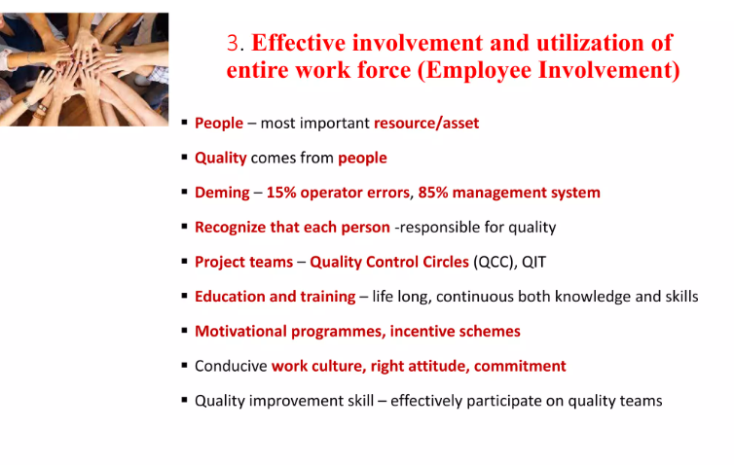

Slide 24
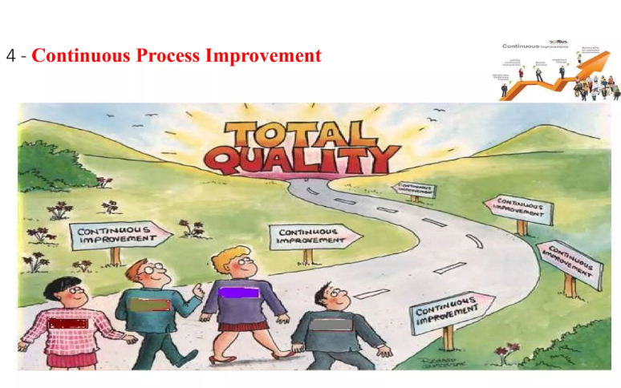

Slide 25
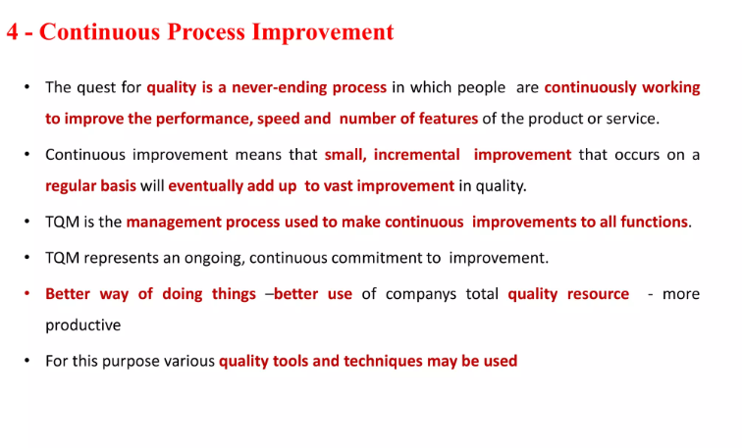

Slide 26
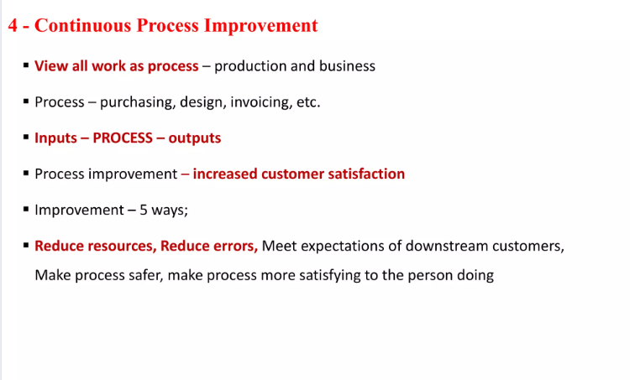

Slide 27
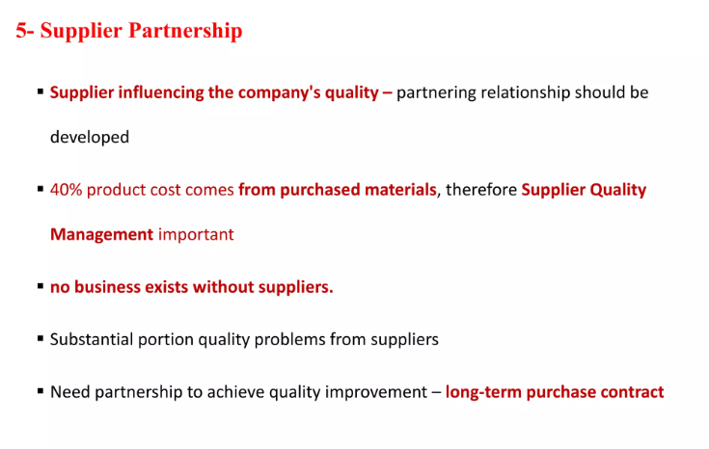

Slide 28
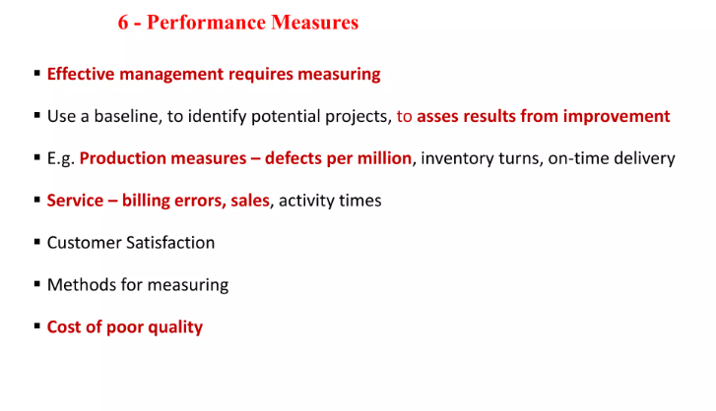

Slide 29
Principles of TQM
The five main principles are
Management Commitment
Employee Empowerment
Fact Based Decision making
Continuous Improvement
Customer Focus.

Slide 30
In management commitment, the first step is to design and plan followed by deployment. After getting it deployed the product is processed for critique, examined and revised.
Concept of Continuous Improvement It gives three ways to make product better and better.
The first measure is to avoid mistakes while developing a product. Inspection at each step can also be another important step to avoid errors so that these errors cannot proceeds to next step and become a cause for new errors.
The solution for this step is to stop at the point where error is found, go back and make corrections, test that module and then proceed further. This will lead a better process cycle.

Slide 31
Process-Centered: Processes are mapped, analyzed, and improved for better efficiency and effectiveness.
Integrated System: All departments work together with a common purpose of improving quality.
Data-Driven Decision Making: Decisions are made based on data and performance measurements rather than intuition or assumptions.
Communication: Effective communication between all parts of the organization ensures alignment and clarity of objectives.

Slide 32
Evaluation of Quality Models and Standards:
-> ISO Standards (International Organization for Standardization):ISO develops international standards to ensure quality, consistency, and customer satisfaction across products and services.
-> CMM / CMMI (Capability Maturity Model Integration)
Used mainly in software development.
-> Six Sigma
Six Sigma aims to reduce defects to 3.4 defects per million opportunities.

Slide 33
ISO 9126 QUALITY CHARACTERISTICS
to define a general framework for software quality.
An expert group, under the aegis of the ISO, standardized a software quality document, namely, ISO 9126, which defines six broad, independent categories of quality characteristics as follows:

Slide 34
Functionality: A set of attributes that bear on the existence of a set of functions and their specified properties. The functions are those that satisfy stated or implied needs.
Reliability: A set of attributes that bear on the capability of software to maintain its performance level under stated conditions for a stated period of time.
Usability: A set of attributes that bear on the effort needed for use and on the individual assessment of such use by a stated or implied set of users.
Efficiency: A set of attributes that bear on the relationship between the software’s performance and the amount of resource used under stated conditions.
Maintainability: A set of attributes that bear on the effort needed to make specified modifications (which may include corrections, improvements, or adaptations of software to environmental changes and changes in the requirements and functional specifications).
Portability: A set of attributes that bear on the ability of software to be transferred from one environment to another (this includes the organizational,hardware or, software environment).

Slide 35
Evaluation of Quality Models and Standards:
ISO Standards (International Organization for Standardization):
ISO 9000 – Fundamentals and Vocabulary: It defines basic quality concepts and terminology. Also Acts as a foundation for other ISO standards. It's not a certification standard
ISO 9001: The most recognized standard, focusing on quality management systems. It emphasizes customer satisfaction, process improvement, and meeting regulatory requirements.
ISO 14001: Focuses on environmental management systems, helping organizations minimize their environmental impact.
ISO/IEC 27001: Concerned with information security management systems (ISMS).

Slide 36
What is ISO 9000
What is standard?
“A standard is simply a definition of how something should be.”
ISO 9000 is the standard which is most widely known among all the standards given by ISO and it gives guidelines for selecting a project.
ISO 9000 is generic and applied to all generic product categories which can be hardware, and software.
These standards are widely accepted worldwide and have an effect on national and international trade.
These standards are used by management systems in an organization to design, produce and support their products.

Slide 37
ISO 9000:2000
ISO 9000 series gives guidelines for selecting a product. ISO 9000 series standards are applied in government and other organizations and make easier and faster development and maintenance of products.
It also develops a leadership and good customer and supplier relations.
The advantage of giving guidelines is that the customer is aware beforehand and can get quality in terms of performance and efficiency of the product.
If any system conforms to standard that mean it will perform well and will be satisfying customer’s need.

Slide 38
ISO 9001:2000
Seaver Matt has called ISO 9001 series as quality management system requirements.
It is not concerned with the cost and finance effectiveness but on those purposes that indirectly affects the quality of the product.
So, it does not help any organizations to deal with economic states and money affairs.
The factors on which ISO 9001 focus are the personal aspects like specific sales and marketing of the product.
The product should match the standards set in order to advertise it for use.

Slide 39
ISO 9004:2000
‘ISO 9004 is recommended as a guide for organizations whose top management wishes to move beyond the requirements of ISO 9001 in pursuit of continual improvement of Performance.’ (Seaver, Matt.).
It covers a large scope creep and is deliberately positioned between ISO 9000 and award criteria.
It consists of those features which directly affects the product quality and provide a guideline to enrich and improve the ISO 9001 baseline.
These all above defined standards series together improves product quality and service to customer.

Slide 40
ISO 9000:2000 SOFTWARE QUALITY STANDARD
There are ongoing efforts at the international level for standardizing different aspects of computer communications and software development. Standardization has been particularly successful in the field of computer networking and wireless communications.
For example, the collaborative work of the Internet Engineering Task Force (IETF) has been the key to the proliferation of the Internet. Similarly, standardization efforts from the IEEE have led to the successful development of the local area network (LAN) standard, namely the IEEE 802.3 standard, and the wireless local area network (WLAN) standards, namely IEEE 802.11a/b/g.
The ISO has developed a series of standards, collectively known as the ISO 9000. The ISO was founded in 1946, and it is based in Geneva, Switzerland. It develops and promotes international standards in the field of quality assurance and quality management.

Slide 41
The ISO 9000 standards are generally applicable to all tangible products manufactured with human endeavor, say, from spices to software—Even some brands of spice and rice used in everyday cooking are claimed to be ISO 9000 certified.
The ISO 9000 standards are reviewed and updated from time to time, once every 5–8 years. The latest ISO 9000 standards released in the year 2000 are referred to as ISO 9000:2000.
There are three components of the ISO 9000:2000 standard as follows:
ISO 9000 : Fundamentals and vocabulary
ISO 9001 : Requirements
ISO 9004 : Guidelines for performance improvements [9]

Slide 42
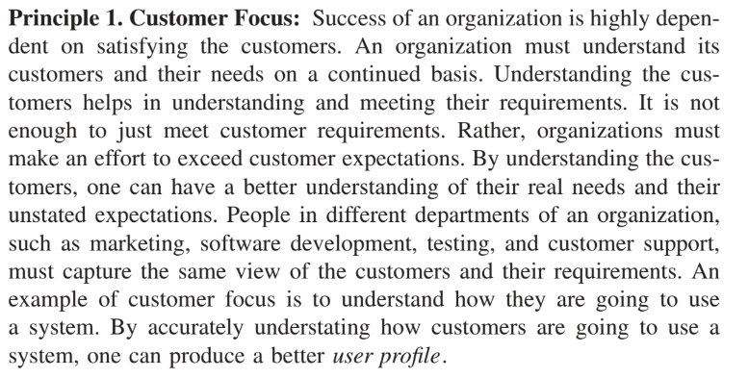
ISO 9000:2000 Fundamentals
The ISO 9000:2000 standard is based on the following eight principles:

Slide 43
Principle 2. Leadership:
Leaders set the direction their organization should take, and they must effectively communicate this to all the people involved in the process.
All the people in an organization must have a coherent view of the organizational direction.
Without a good understanding of the organizational direction, employees will find it difficult to know where they are heading.
Leaders must set challenging but realistic goals and objectives. Employee contribution should be recognized by the leaders.
Leaders create a positive environment and provide support for the employees to collectively realize the organizational goal.
They reevaluate their goals on a continual basis and communicate the findings
to the staff.

Slide 44
Principle 3. Involvement of People:
In general, organizations rely on people. People are informed of the organizational direction, and they are involved at all levels of decision making.
People are given an opportunity to develop their strength and use their abilities. People are encouraged to be creative in performing their tasks.
Principle 4. Process Approach:
There are several advantages to performing major tasks by using the concept of process.
A process is a sequence of activities that transform inputs to outputs. Organizations can prepare a plan in the form of allocating resources and scheduling the activities by making the process defined, repeatable, and measurable.

Slide 45
Principle 5. System Approach to Management:
A system is an interacting set of processes. A whole organization can be viewed as a system of interacting processes.
In the context of software development, we can identify a number of processes.
For example, gathering customer requirements for a project is a distinct process involving specialized skills.
Principle 6. Continual Improvement:
Continual improvement means that the processes involved in developing, say, software products are reviewed on a periodic basis to identify where and how further improvements in the processes can be effected.
Since no process can be a perfect one to begin with, continual improvement plays an important role in the success of organizations.

Slide 46
Principle 7. Factual Approach to Decision Making:
Decisions may be made based on facts, experience, and intuition. Facts can be gathered by using a sound measurement process. Identification and quantification of parameters are central to measurement.
Once elements are quantified, it becomes easier to establish methods to measure those elements.
There is a need for methods to validate the measured data and make the data available to those who need it.

Slide 47
Principle 8. Mutually Beneficial Supplier Relationships:
Organizations rarely make all the components they use in their products.
It is a common practice for organizations to procure components and subsystems from third parties.
An organization must carefully choose the suppliers and make them aware of the organization’s needs and expectations.
The performance of the products procured from outside should be evaluated, and the need to improve their products and processes should be communicated to the suppliers.
A mutually beneficial, cooperative relationship should be maintained with the suppliers.

Slide 48
ISO 9001:2000 Requirements
The five major parts of the ISO 9001:2000
Systemic Requirements The concept of a quality management system
(QMS) is the core of part 4 of the ISO 2001:2000 document.
A quality management system is defined in terms of quality policy and quality objectives.
In the software development context, an example of a quality policy is to review all work products by at least two skilled persons.

Slide 49
Systemic Requirements The concept of a quality management system
(QMS) is the core of part 4 of the ISO 2001:2000 document. A quality management system is defined in terms of quality policy and quality objectives.
In the software development context, an example of a quality policy is to review all work products by at least two skilled persons.
Another quality policy is to execute all the test cases for at least two test cycles during system testing. Similarly, an example of a quality objective is to fix all defects causing a system to crash before release.
Mechanisms are required to be defined in the form of processes to execute the quality policies and achieve the quality objectives.

Slide 50
Documentation is an important part of a QMS. There is no QMS without proper documentation.
A QMS must be properly documented by publishing a quality manual. The quality manual describes the quality policies and quality objectives.
Procedures for executing the QMS are also documented. As a QMS evolves by incorporating improved policies and objectives, the documents must accordingly be controlled.
The documentation part can be summarized as follows:
Document the organizational policies and goals. Publish a vision of the organization.
Document all quality processes and their interrelationship.
Implement a mechanism to approve documents before they are distributed.
Review and approve updated documents.
Monitor documents coming from suppliers.
Document the records showing that requirements have been met.
Document a procedure to control the records.

Slide 51
Management Requirements
The concept of quality cannot be dealt with in bits and pieces by individual developers and test engineers.
Rather, upper management must accept the fact that quality is an all-pervasive concept.
Upper management must make an effort to see that the entire organization is aware of the quality policies and quality goals.
This is achieved by defining and publishing a QMS and putting in place a mechanism for its continual improvement.
The QMS of the organization must be supported by upper management with the right kind and quantity of resources.

Slide 52
Generate an awareness for quality to meet a variety of requirements, suchas customer, regulatory, and statutory.
• Develop a QMS by identifying organizational policies and goals concerning quality, developing mechanisms to realize those policies and goals, and allocating resources for their implementations.
• Develop a mechanism for continual improvement of the QMS.
• Focus on customers by identifying and meeting their requirements in order to satisfy them.
• Develop a quality policy to meet the customers’ needs, serve the organization itself, and make it evolvable with changes in the marketplace and new developments in technologies.

Slide 53
Resource Requirements
Resources are key to achieving organizational policies and objectives.
Statements of policies and objectives must be backed up with allocation of the right kind and quantity of resources.
There are different kinds of resources, namely, staff, equipment, tool, financial, and building, to name the major ones.
Different resources are controlled by different divisions of an organization.
Resources are allocated to projects on a need basis.
Every activity in an organization needs some kind of resources, the resource management processes interact with other kinds of processes.

Slide 54
The important activities concerning resource management are as follows:
Identify and provide resources required to support the organizational quality policy in order to realize the quality objectives. Here the key factor is to identify resources to be able to meet—and even exceed–customer expectations.
• Allocate quality personnel resources to projects. Here, the quality of personnel is defined in terms of education, training, experience, and skills.
• Put in place a mechanism to enhance the quality level of personnel.
This can be achieved by defining an acceptable, lower level of competence.
For personnel to be able to move up to the minimum acceptable level of competence, it is important to identify and support an effective training
program. The effectiveness of the training program must be evaluated on
a continual basis.

Slide 55
Realization Requirements
This part deals with processes that transform customer requirements into products. The reader may note that not much has changed from ISO 9001:1994 to ISO 9001:2000 in the realization part.
The key elements of the realization part are as follows:
Develop a plan to realize a product from its requirements. The important elements of such a plan are identification of the processes needed to develop a product, sequencing the processes, and controlling the processes. Product quality objectives and methods to control quality during development are identified during planning.
To realize a product for a customer, much interaction with the customer is necessary to understand and capture the requirements. Capturing requirements for a product involves identifying different categories of requirements, such as requirements generated by the customers, requirements necessitated by the product’s use, requirements imposed by external agencies, and requirements deemed to be useful to the organization itself.

Slide 56
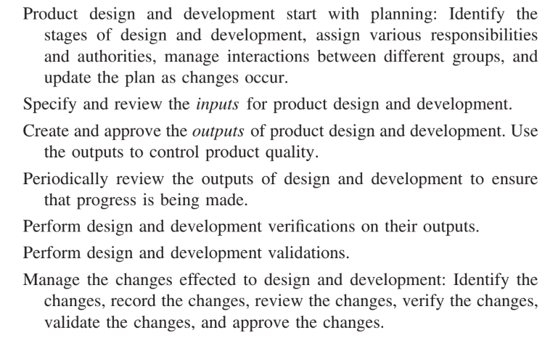
3. Review the customers’ requirements before committing to the project.Requirements that are not likely to be met should be rejected in this phase.Moreover, develop a process for communicating with the customers. It is important to involve the customers in all phases of product development.
Once requirements are reviewed and accepted, product design and development take place:

Slide 57
Remedial Requirements
This part is concerned with measurement,analysis of measured data, and continual improvement.
Measurement of performance indicators of processes allows one to determine how well a process is performing.
If it is observed that a process is performing below the desired level, then corrective action can be taken to improve the performance of the process.

Slide 58
BASIC IDEA IN SOFTWARE PROCESS
The concept of a process plays an important role in today’s software development. Without a repeatable process, the only repeatable results you are likely to produce are errors.
In the software engineering context, a process comprises a set of activities that are executed to develop software products.
The activities find expressions in the form of methods, techniques, strategies, procedures, and practices.
Those activities heavily rely on information repositories such as documents, standards, and policies.
Different processes are driven by different goals and availability of resources.

Slide 59
The concept of a process is applied not just to develop source code, but to other software-related products, such as a project plan, requirements document, design document, and user manual, as well.
It is effective to follow a defined process because of the following benefits:
The process can be repeated in subsequent projects.
The process can be evaluated by using a variety of metrics, such as cost,quality, and time to deliver a product.
Actions can be taken to improve the process to achieve better results.
A process for software development consists of several different processes for its different component tasks. For example, gathering the requirements of a system,constructing a functional specification of a system, designing a system, testing a system, and maintaining a system are different tasks to be performed in the life cycle of a software system.

Slide 60
CMM (Capability Maturity Model):
A framework that helps organizations improve their software development processes by measuring their maturity level across key areas (initial, managed, defined, quantitatively managed, and optimizing).
CMM has been evolved into CMMI (Capability Maturity Model Integration) for broader applications across various industries.

Slide 61
CMM (Capability Maturity Model):
In software development processes we seek three desirable attributes as follows:
1. The products are of the highest quality. Ideally, a product should be free of defects. However, in practice, a small number of defects with less severe consequences are generally tolerated.
2. Projects are completed according to their plans, including the schedules.
3. Projects are completed within the allocated budgets.
Developers of large software products rarely achieve the above three attributes.
Due to the complex nature of software systems, products are released with known and unknown defects.
The unknown defects manifest themselves as unexpected failures during field operation, that is, when we know that the system was released with unknown defects.

Slide 62
The maturity level of a development process tells us to what extent the organization is capable of producing low-cost, high-quality software.
Therefore the evaluation framework is the CMM. After evaluating the current maturity level of a development process, organizations can work on improving the process to achieve the next higher level of process maturity.
In the CMM framework, a process has five maturity levels. Before going into the details of different maturity levels, it is useful to have a glimpse of an immature process—an organization can be considered to be immature if it follows immature processes

Slide 63
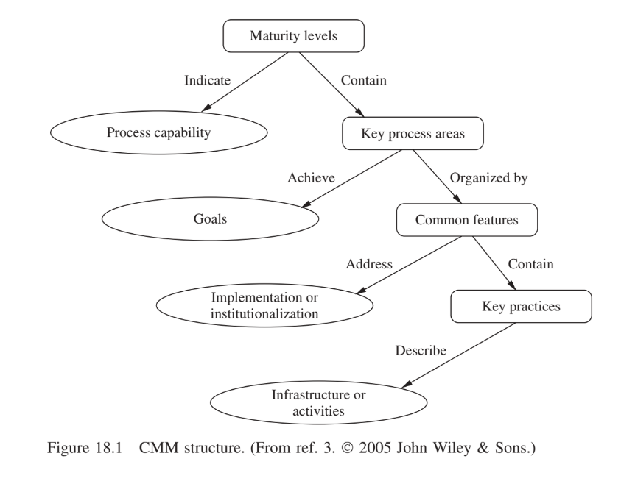
CMM Architecture
A maturity level indicates process capability and contains key process areas (KPAs).The KPAs for each level are listed in Figure 18.2.

Slide 64
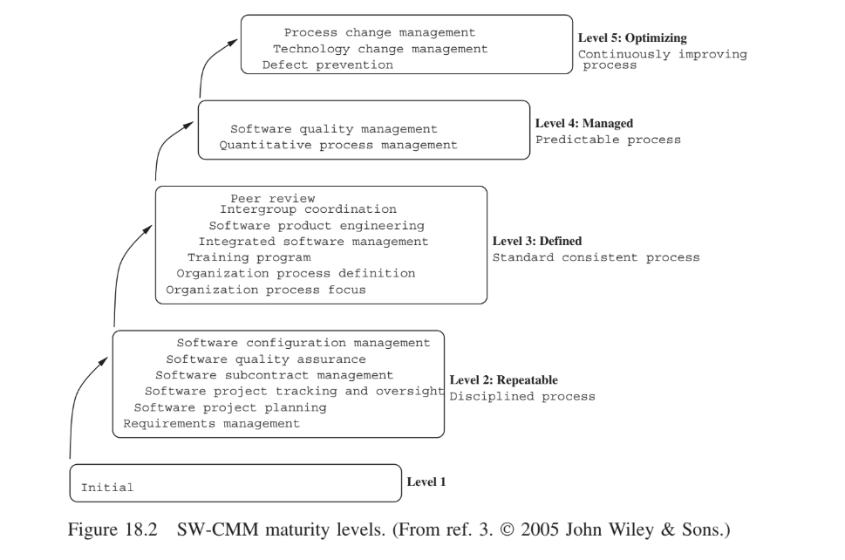

Slide 65
A maturity level indicates process capability and contains key process areas (KPAs).
Key process areas are expected to achieve goals and are organized by
common features.
• Common features contain key practices and address implementation or institutionalization of the key practices.
• Key practices describe infrastructure or activities.
• When the key practices are followed, the goals of the KPAs are expected to be achieved.
• A maturity level is reached by meeting all the goals of all the KPAs at that level.

Slide 66
Five Levels of Maturity and Key Process Areas
Level 1: Initial At this level, software is developed by following no process model. There is not much planning involved. Even if a plan is prepared, it may not be followed. Individuals make decisions based on their own capabilities and skills.
There is no KPA associated with level 1. An organization reaches level 1 without making any effort.
Level 2: Repeatable At this level, the concept of a process exists so that success
can be repeated for similar projects. Performance of the proven activities of past
projects is used to prepare plans for future projects. This level can be summarized
as being disciplined because processes are used for repeatability. All the processes
are under the effective control of a project management system. The KPAs at level 2
are as follows:

Slide 67
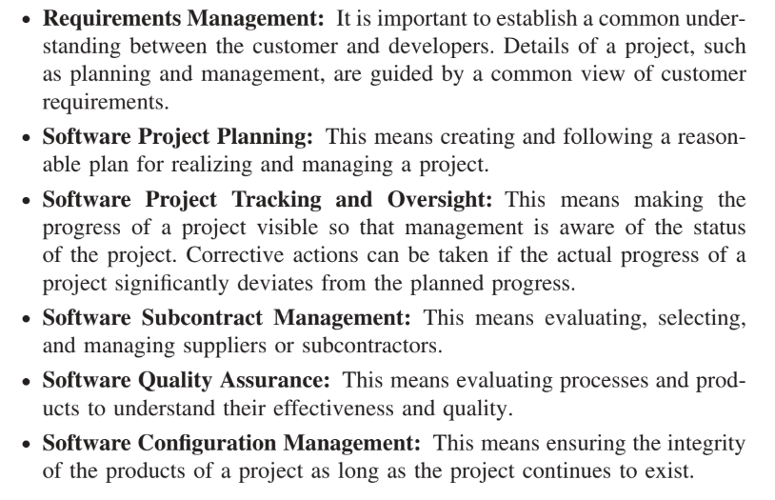

Slide 68
Level 3: Defined At this level, documentation plays a key role. Processes that are related to project management and software development activities are documented, reviewed, standardized, and integrated with organizational processes.
In other words, there is organizationwide acceptance of standard processes.
Software development is carried out by following an approved process. Functionalities and the associated qualities are tracked. Cost and schedule are monitored to keep them under control.

Slide 69
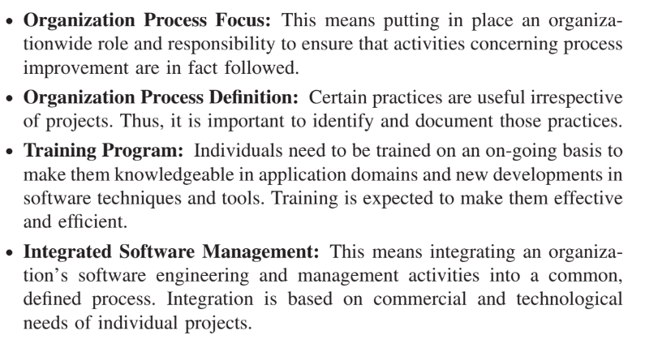

Slide 70
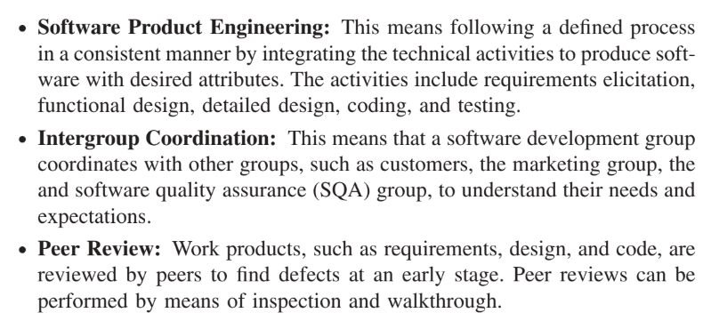

Slide 71
Level 4: Managed At this level, metrics play a key role. Metrics concerning processes and products are collected and analyzed. Those metrics are used to gain quantitative insight into both process and product qualities.
When the metrics show that limits are being exceeded, corrective actions are triggered.
For example, if too many test cases fail during system testing, it is useful to start a process of root cause analysis to understand why so many tests are failing. The KPAs at level 4 are as follows:

Slide 72
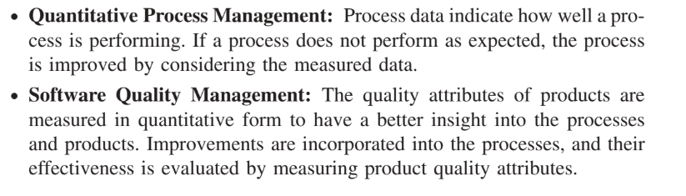

Slide 73
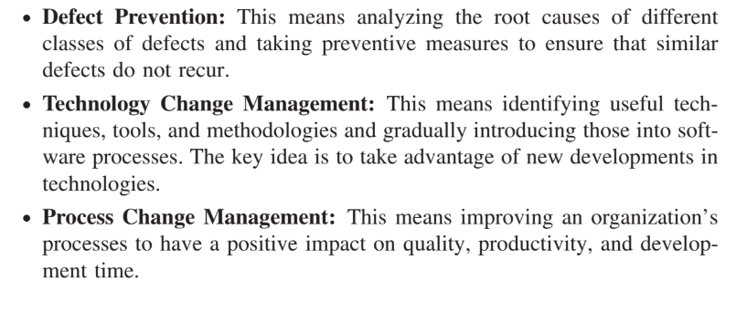
Level 5: Optimizing At this level, organizations strive to improve their processes on a continual basis. This is achieved in two steps: (i) Observe the effects of processes, by measuring a few key metrics, on the quality, cost, and lead time of software products and (ii) effect changes to the processes by introducing new techniques, methods, tools, and strategies. The following are the KPAs at level 5:

Slide 74
Six Sigma:
Six Sigma is a set of methodologies and tools used to improve business processes by reducing defects and errors, minimizing variation, and increasing quality and efficiency
A data-driven approach to improving process quality by identifying and eliminating defects.
Six Sigma uses the DMAIC (Define, Measure, Analyze, Improve, Control) methodology to enhance processes.
The goal is to reduce variation and ensure that processes produce outcomes that fall within the specified limits.

Slide 75
Six Sigma is different from the other processes in a way that it mainly concentrates on measuring the existing process while the other provides a way to create a new process for producing a product.
Six Sigma measures existing process and will modify it in a way that number of defects is reduced.
Using Six Sigma we can only reduce the number of defects but we cannot produce zero defective system.

Slide 76
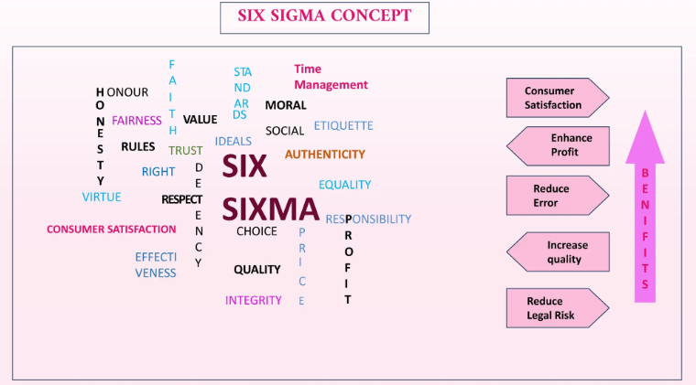

Slide 77
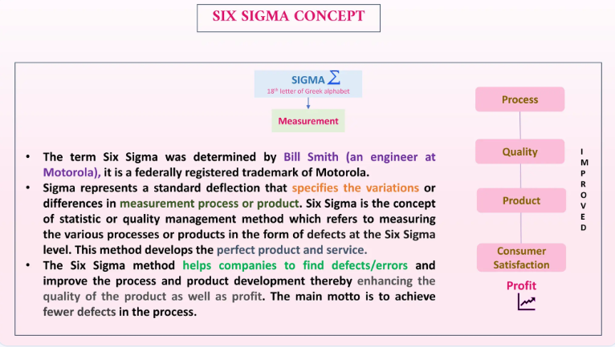

Slide 78
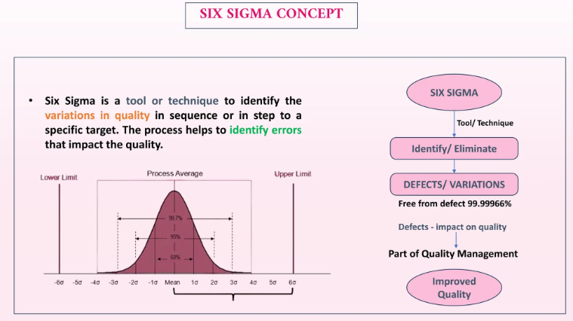

Slide 79
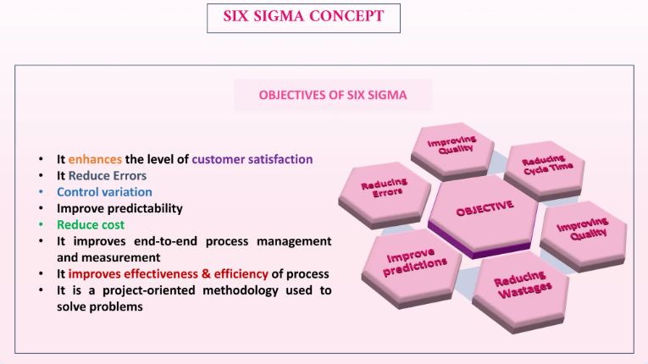

Slide 80
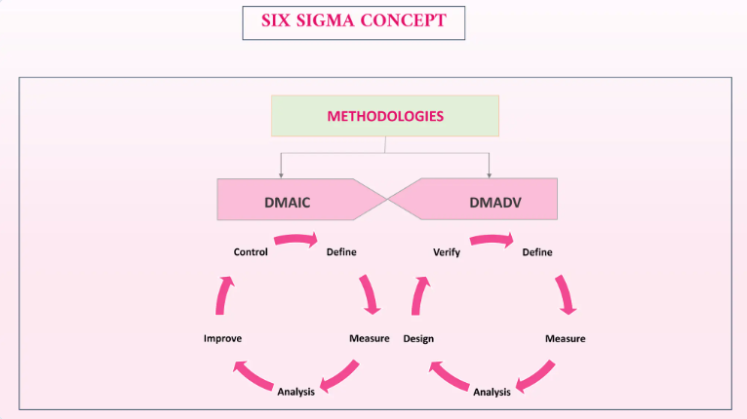

Slide 81
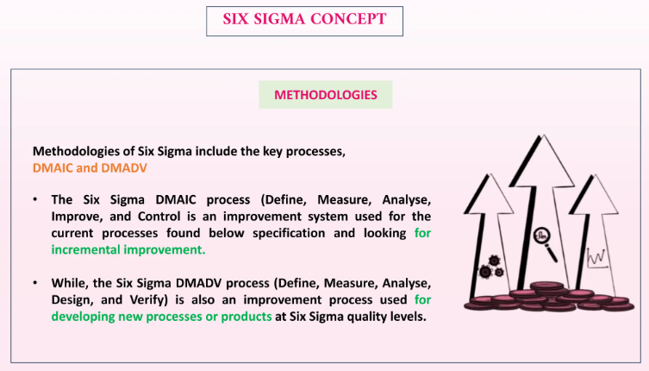

Slide 82
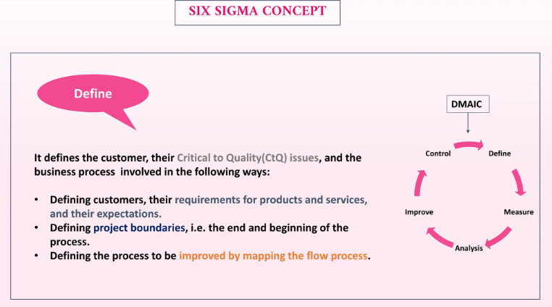

Slide 83
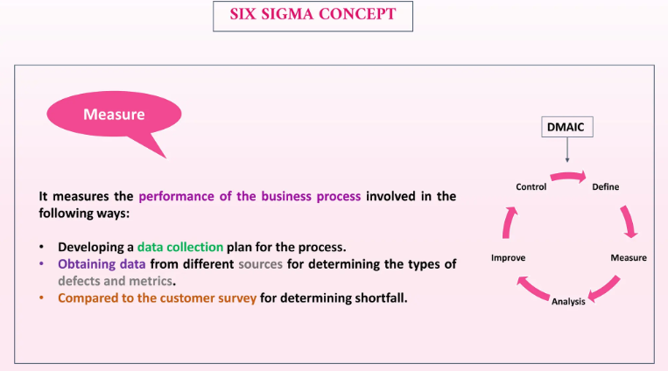

Slide 84
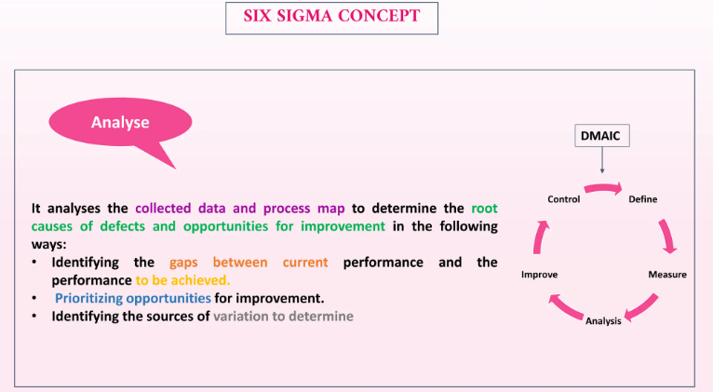

Slide 85
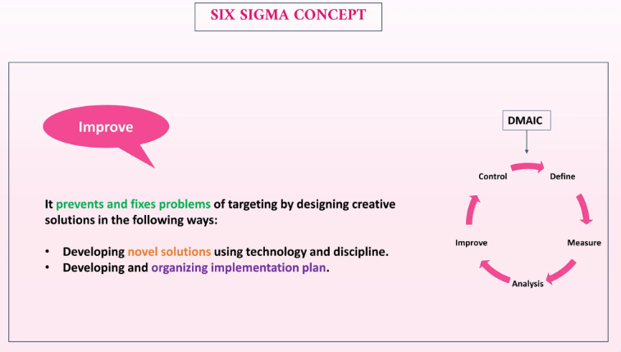

Slide 86
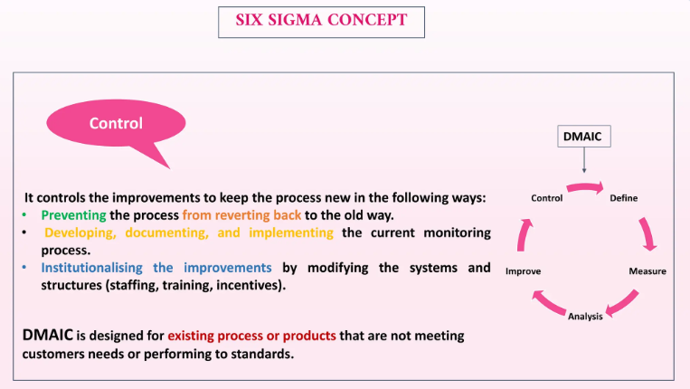

Slide 87
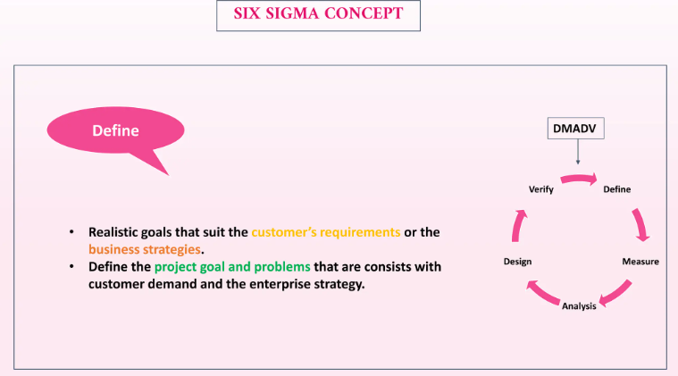

Slide 88
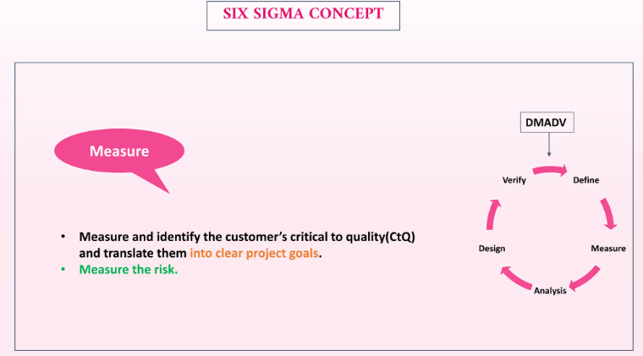

Slide 89
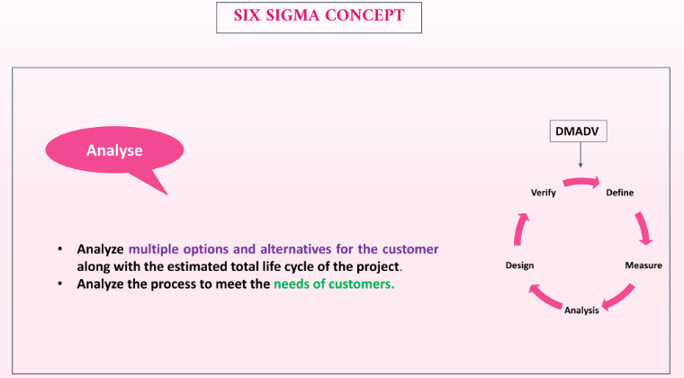

Slide 90
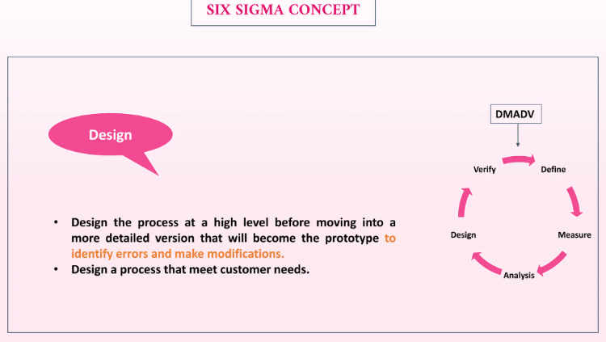

Slide 91
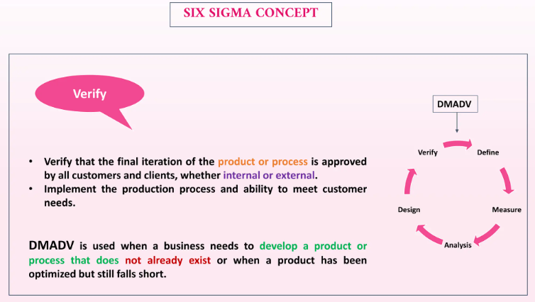

Slide 92
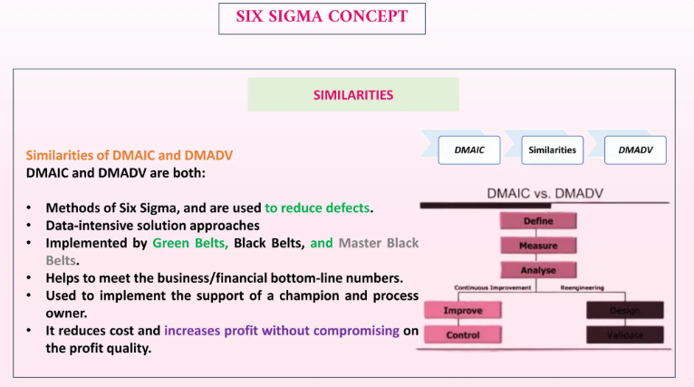

Slide 93
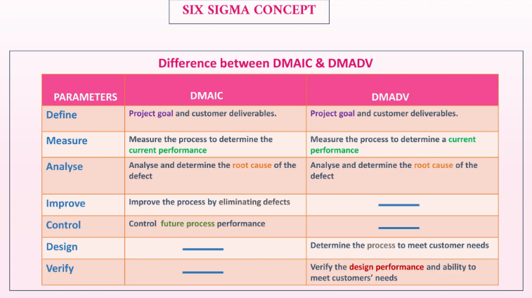

Slide 94
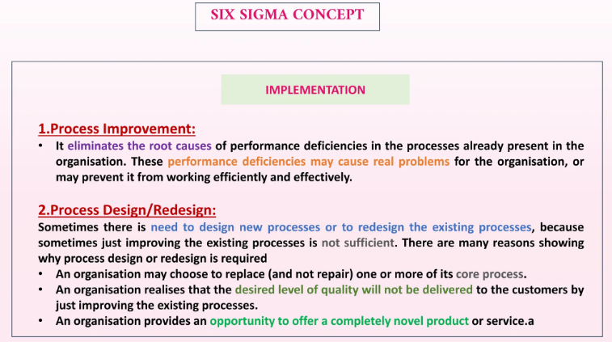

Slide 95
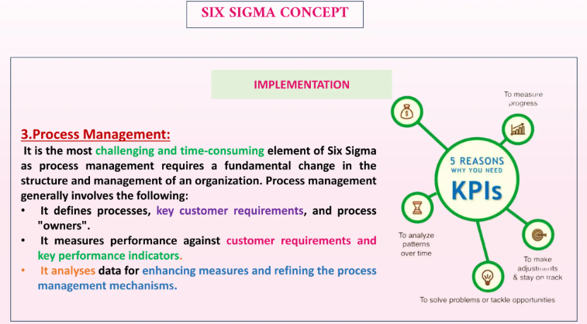

Slide 96
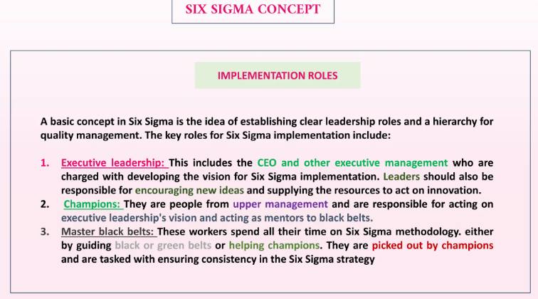

Slide 97
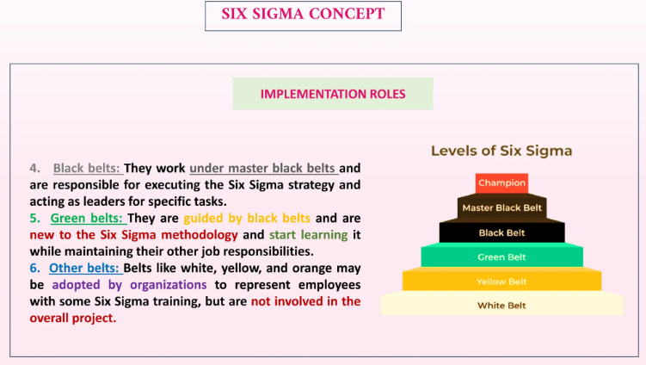

Slide 98
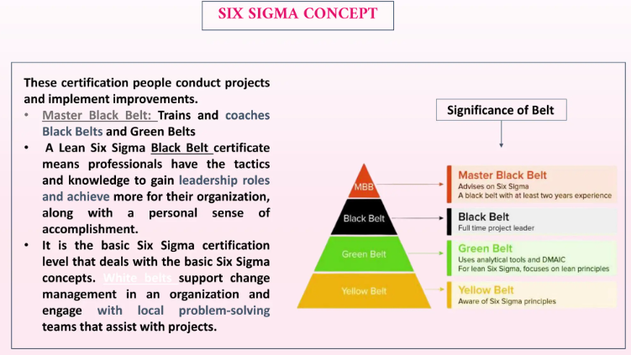

Slide 99
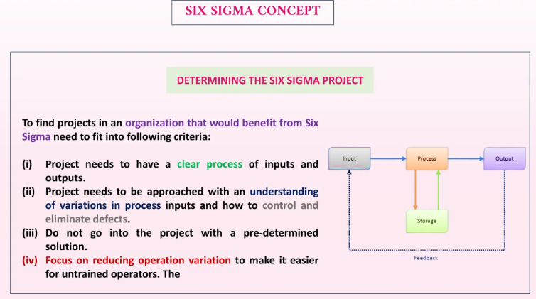

Slide 100
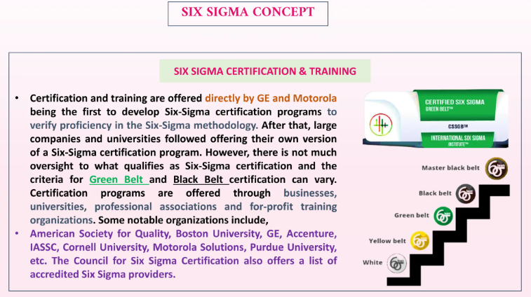

Slide 101
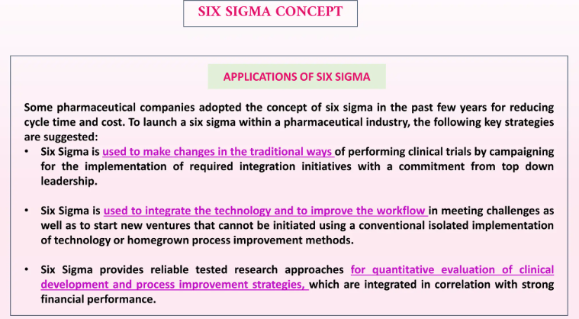

Slide 102
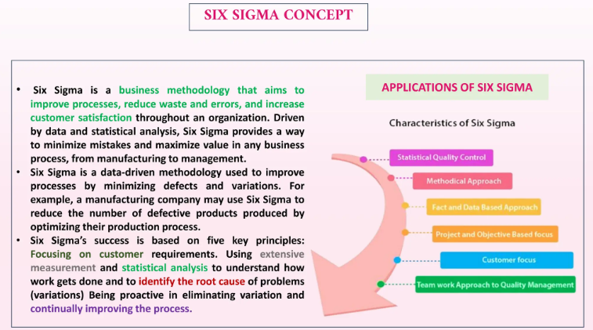

Slide 103
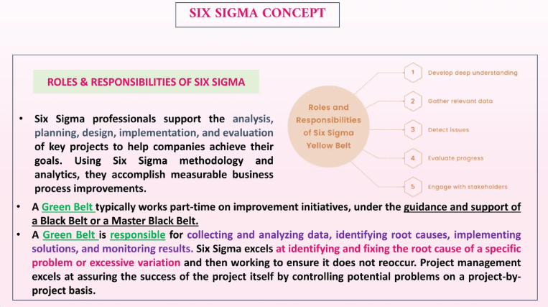

Slide 104
Why is It Six Sigma
Six Sigma concentrates on the variation of data in a data set.
Variation of data will be in a very predictable manner, most of the data will fall under the middle.
We measure variation in terms of Standard deviation.
“Standard deviation is a well-founded measure of the range of variation from the average for a group of measurements”

Slide 105
Six Sigma is a “process measuring” process which typically involves seven steps and has a feedback loop. Those seven steps are
1. The first step is looking at the product in which we study what the product is, quality of the product and the way we are producing it.
2. Next, we try to identify the defects in the product. “Defect means anything that holds your product from being its best.”
3. After identifying the defects in the product, we will look at the process. Here we understand the complete process which we are using to produce a product. If we have some defects in the product it is very likely to have defects in the process that is used to produce that product.
4. Then we identify the sources for the defects.
5. Once we know the actual sources for the defects then we improve the existing process by eliminating the actual sources for defects.
6. Then we will use the new process.
7. Again, we will go to step 1 which indicates the feedback loop and also clearly states that Six Sigma is a continuous process and always tries to make process better and better

Slide 106
Methodologies of Six Sigma
There are two methodologies implemented by Six Sigma first one called DMIAV for improving the existing process, on which Six Sigma mainly concentrates on.
Second one called Design for Six Sigma (DFSS) used for designing a new process for a new product.

Slide 107
DMAIC (Define, Measure, Analyze, Improve and Control) -- Define: This phase still includes some more sub processes which are • Defining the problem in which we define the actual target of the program • Defining the project in which we define the scope of the project • Defining the goal in which we state the approach of doing the project • Defining the boundary conditions in which the boundary of the project is defined so that our project does not go out of scope • Developing the project plan in which the project plan is prepared using the above statements • Initiating the plan in which the prepared plan is implemented

Slide 108
Addressing Quality Challenges:
Resource Constraints: Limited resources (time, budget, manpower) can affect the quality of the end product.
Changing Requirements: As customer needs and market conditions evolve, maintaining consistent quality can be a challenge.
Resistance to Change: Employees may resist new processes, methodologies, or quality improvements.
Data Collection & Analysis: Insufficient or poor data collection can lead to incorrect decisions and undermine quality improvements.
Lack of Training: Without ongoing training and skills development, employees may not be equipped to meet quality standards.
Supplier Issues: Poor quality materials or unreliable suppliers can negatively affect the quality of the final product.

Slide 109
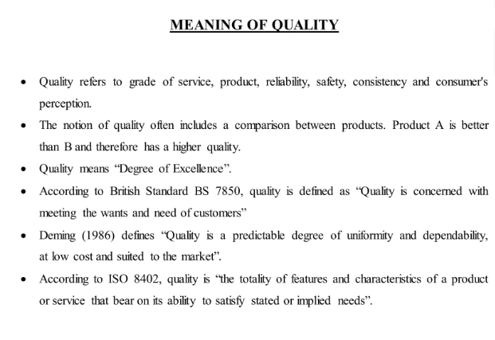

Slide 110
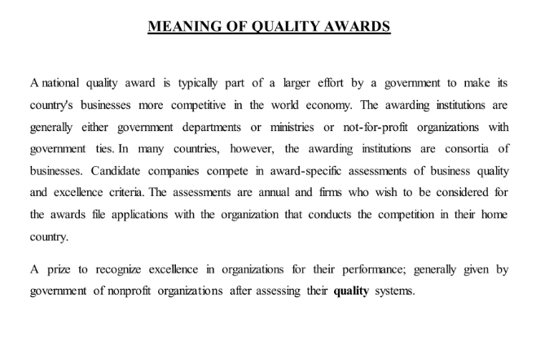

Slide 111
Significance of National Quality Awards:
Recognition of Excellence: National quality awards highlight organizations that excel in quality management and serve as role models for others.
Continuous Improvement: They promote a culture of continuous improvement by encouraging organizations to assess and improve their quality management systems.
Benchmarking: Companies can use these awards as benchmarks to measure their performance against industry leaders.
Customer Trust: Winning quality awards can improve customer confidence, leading to enhanced brand reputation.
Competitive Advantage: Organizations that achieve these awards gain a competitive edge in the marketplace, demonstrating their commitment to quality.

Slide 112
Examples of National Quality Awards:
Deming Prize (Japan): Recognizes companies that have implemented Total Quality Management (TQM) principles.
Malcolm Baldrige National Quality Award (USA): Encourages American organizations to adopt TQM and improve their business processes.
European Quality Award (Europe): Recognizes excellence in European organizations based on the EFQM (European Foundation for Quality Management) model.

